Slide 1
PRESS RELEASE
Ghana, October 2023
CONSUMER PRICE INDEX AND INFLATION
15th November 2023

Slide 2
In this release, we present:
Definition and Measurement of Consumer Price Index (CPI) and Rate of Inflation
CPI and Rate of Inflation for October 2023
Dominant Divisions of Rate of Inflation for October 2023
Disaggregation of Rate of Inflation for October 2023
Highlights of CPI and Rate of Inflation for October 2023
National, Regional and Household Level Issues for Wider Engagement
1

Slide 3
Definition and measurement of CPI and rate of inflation (1/3)
CPI measures changes in the price of a fixed basket of goods and services purchased by households
The assumption is that the basket is purchased each month, hence captures price changes each month
The rate of inflation is the relative change in CPI between periods
Inflation is reported year-on-year (annual inflation) and month-on-month (monthly inflation), and granulated to determine regional and commodity type and source of inflation
2

Slide 4
Definition and measurement of CPI and rate of inflation (2/3)
CPI does not measure price levels
The measures of CPI and inflation are based on the Consumer Price Index Manual: Concepts and Methods
Data (market readings) are captured monthly
Key variables are prices, quantities and expenditure weights of items
Price reference year for the new series is 2021 (2021 = 100)
Analyses of price changes of individual items for wider engagement
3

Slide 5
Definition and measurement of CPI and rate of inflation (3/3)
Price collection is done in 57 markets
Prices are collected from about 8,337 outlets.
Prices are collected for 47,877 products every month from 16 regions.
Products are ordered in a hierarchy of 13 Divisions, 44 Groups, 98 Classes, 156 Subclasses and 307 Items.
Every item can only be part of one Subclass, and every Subclass can only be part of one Class, etc.
4

Slide 6
Consumer Price Index and rate of inflation for October 2023
Month | CPI | Inflation
 |  | Monthly | Yearly
Oct - 2022 | 144.4 | 2.7% | 40.4%
Jan- 2023 | 165.6 | 1.7% | 53.6%
Feb-2023 | 168.7 | 1.9% | 52.8%
Mar-2023 | 166.6 | -1.2% | 45.0%
Apr- 2023 | 170.5 | 2.4% | 41.2%
May-2023 | 178.7 | 4.8% | 42.2%
June-2023 | 184.4 | 3.2% | 42.5%
July-2023 | 191.0 | 3.6% | 43.1%
Aug-2023 | 190.6 | -0.2% | 40.1%
Sept-2023 | 194.2 | 1.9% | 38.1%
Oct-2023 | 195.2 | 0.6% | 35.2%
CPI for October 2023 was 195.2 relative to 144.4 for October 2022
Year-on-year inflation rate for October 2023 was 35.2 percent
This means that in the month of October 2023 the general price level was 35.2 percent higher than October 2022
Month-on-month inflation between September 2023 and October 2023 was 0.6 percent
5
Notes:
The Year-on-Year inflation for October 2023 (35.2%) is 2.9 percentage points lower than the rate recorded in September 2023 (38.1%)
For October 2023, month-on-month inflation was 0.6 percent, indicating a 1.3 percentage points downward change.

Slide 7
Year-on-Year and Month-on-Month Inflation, October 2022 to October 2023
Notes:
Year-on-Year inflation in October 2023 further slows down for the third time in a row, and month-on-month inflation slows down from 1.9 percent to 0.6 percent.
The monthly inflation rate for October 2023 is the third lowest in the last 13 months

Slide 8
Disaggregation of October 2023 Rate of Inflation
Food inflation (0.427) was 44.8%
Last month’s food inflation was 49.4%
Month-on-month food inflation was 0.1%.
Non-food inflation (0.573) was 27.7%
Last month’s non-food inflation was 29.3 %
Month-on-month non-food inflation was 1.0%
Inflation for locally produced items was 34.4%
Inflation for imported items was 37.0%
7
Notes:
On year-on-year basis, the difference between Food inflation (44.8%) and Non-food (27.7%) was 17.1 percentage points.
Year-on-Year Food Inflation reduced by 4.6 percentage points between September 2023 and October 2023 and Non-food inflation reduced by 1.6 percentage points
Month-on-month food (0.1%) was 0.9 percentage points lower than non-food inflation (1.0%) in October 2023
Inflation for locally imported items (34.4%) was 2.6 percentage points lower than imported items (37.0%).

Slide 9
Food and Non-Food Inflation, October 2022 to October 2023
Notes:
Both Food and Non-food inflation drop for the third consecutive month. The food inflation (44.8%) is the second lowest in the last 13 months.
The Non-food inflation (27.7%) is the lowest in the last 13 months.
Steeper declines are observed for food inflation than non-food inflation.

Slide 10
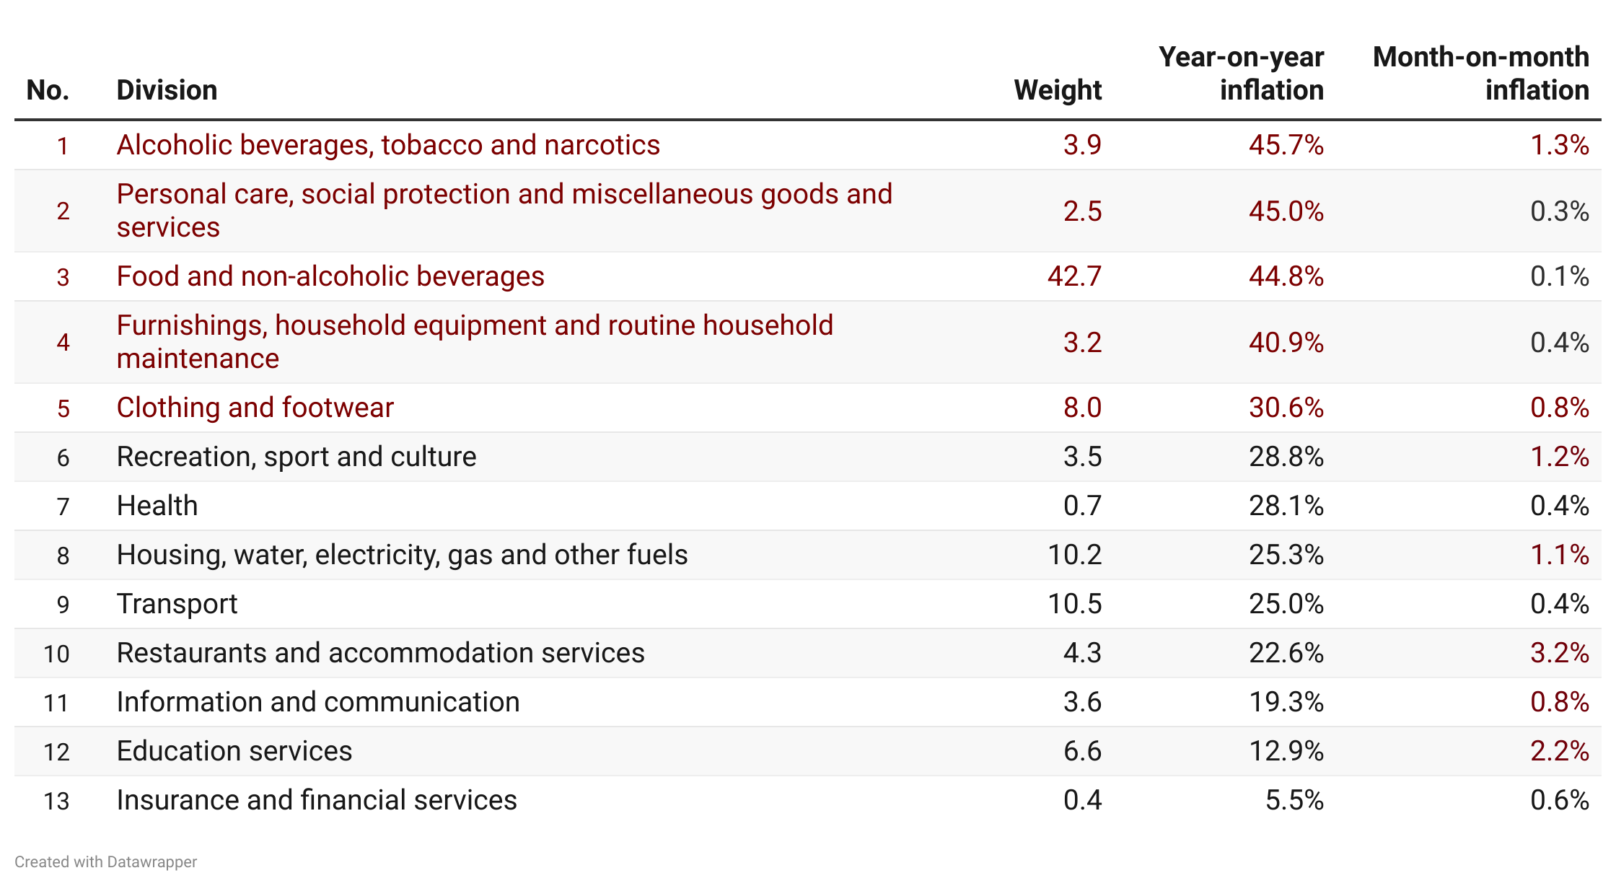
Disaggregation of October 2023 Year-on-year Inflation by Division
9
Notes:
Four divisions record inflation rates higher than the national average (35.2%). This was led Alcoholic beverage, tobacco and narcotics (45.7%), Personal care, social protection and miscellaneous goods and services (45.0%) Food and Non-Alcoholic Beverages (44.8%) and Furnishings, household equipment and routine household (40.9%).
Insurance and Financial Services (5.5%) recorded the lowest rate of inflation.
Restaurants and Accommodation Services (3.2%) recorded the highest month-on-month rate of inflation and food inflation (0.1%), the lowest.
Seven [Restaurants and Accommodation Services (3.2%); Education Services (2.2%), Alcoholic Beverages, Tobacco and Narcotics (1.3%), Recreation Sport and Culture (1.2%), Housing, Water, Electricity, Gas and other Fuels (1.1%), Clothing and Footwear (0.8%) and Information and Communication (0.8%)] of the 13 divisions recorded rates higher than the national monthly inflation of 0.6%.

Slide 11
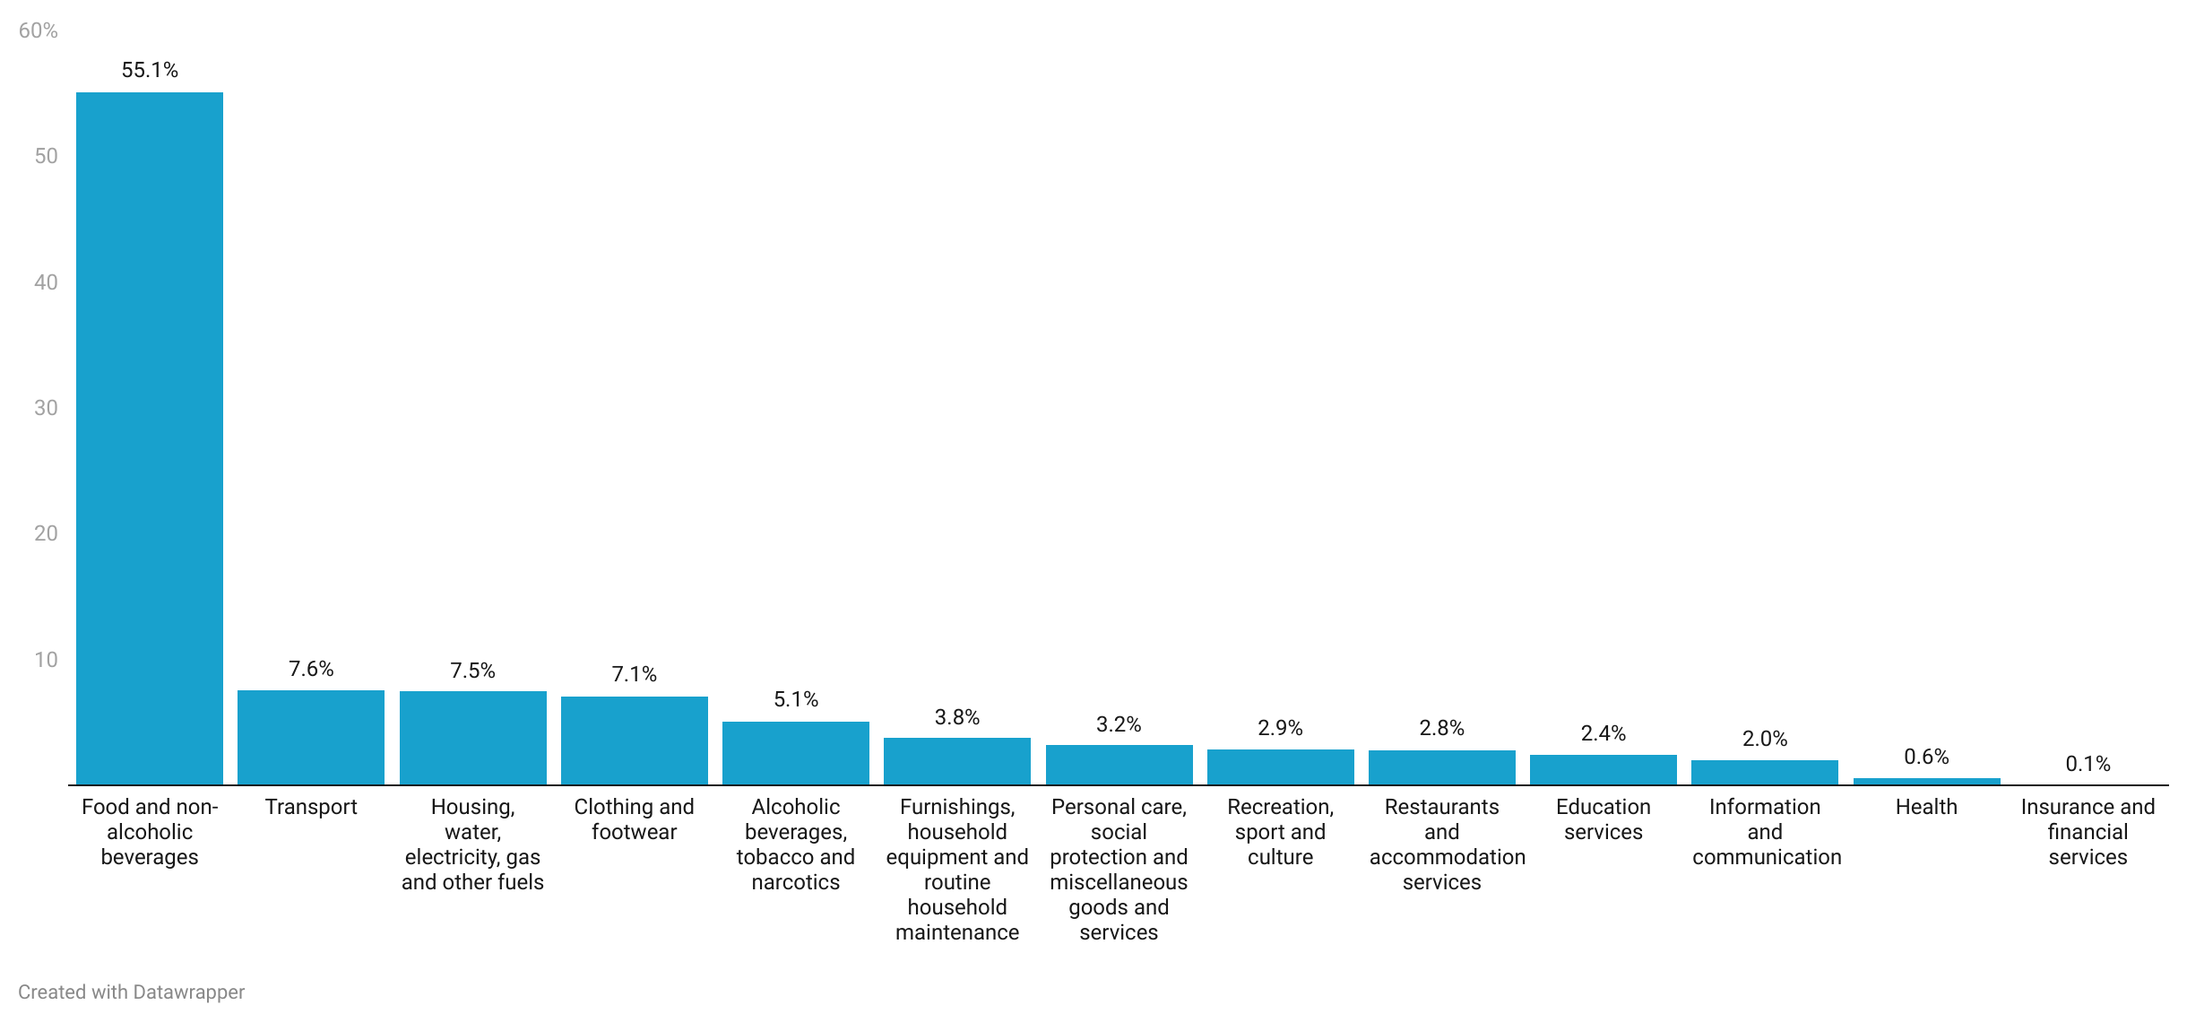
Shares of Inflation Across Divisions for October 2023
10
Notes:
Food and Non-Alcoholic Beverages remains the major driver with a share of more than half (55.1%), followed by Transport (7.6%), Housing, Water, Electricity, Gas and Other Fuels (7.5%) and Clothing and Footwear (7.1%) in October 2023.

Slide 12
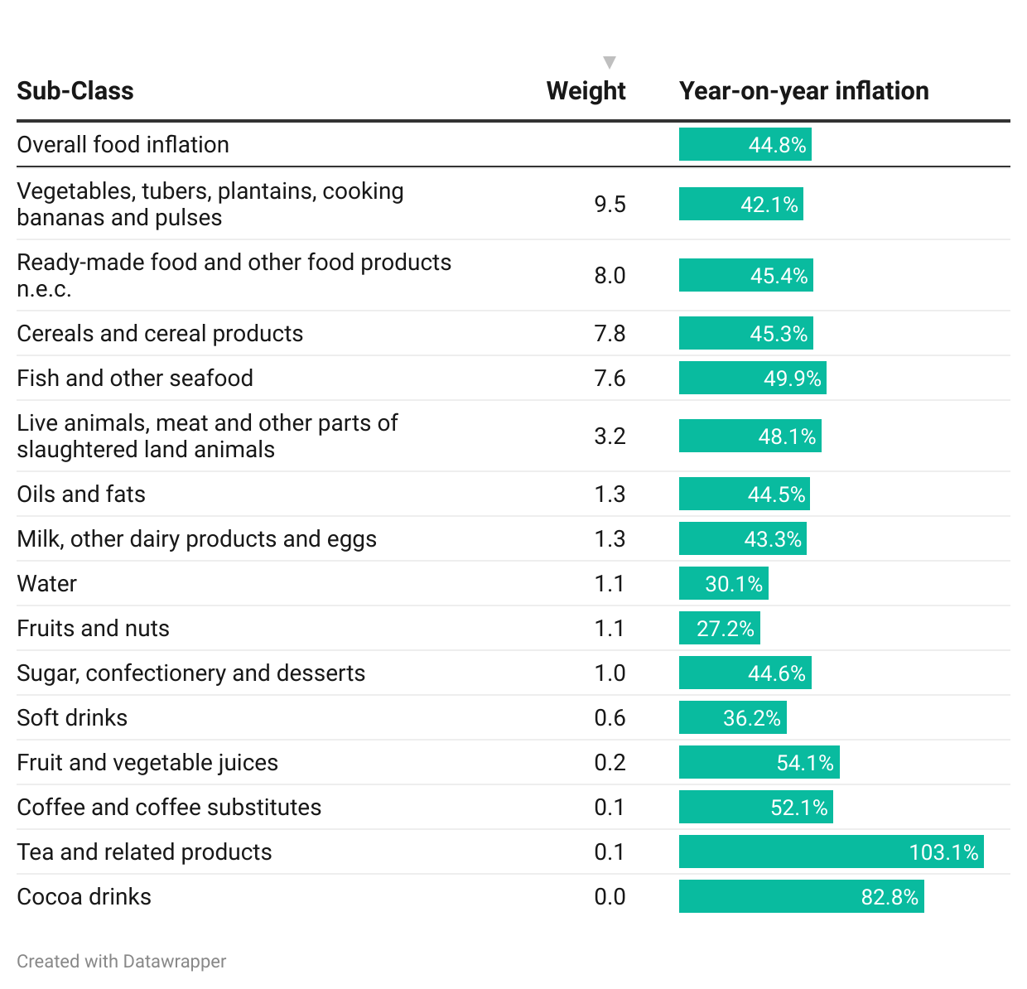
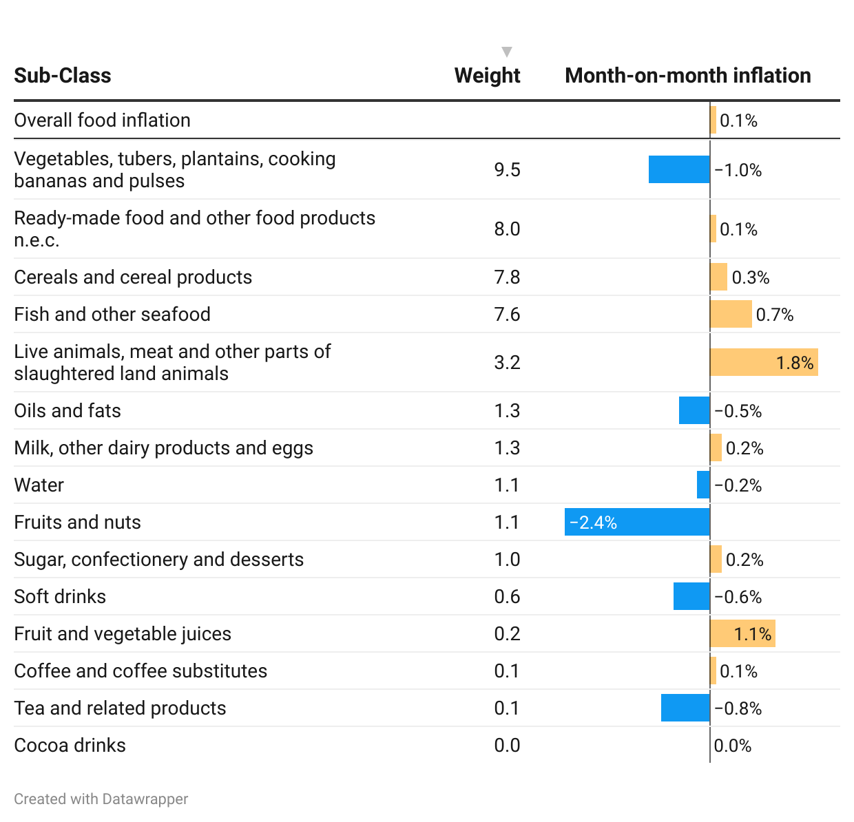
Disaggregation of YoY and MoM Food Inflation by Sub-class
11
Notes:
Focusing on food inflation on a year-on-year basis (44.8%) for October 2023, the top five subclasses contributing the most were Vegetables, tubers, plantains, cooking bananas and pulses (4.0 percentage points of the food inflation rate); Fish and Other Seafood (3.8 percentage points of the food inflation rate); Ready-made food and other food products (3.6 percentage points of the food inflation rate), Cereals and Cereal Products (3.5 percentage points of the food inflation rate); and Live animals, meat and other parts of slaughtered land animals (1.5 percentage points of the food inflation rate).
Live animals, meat and other parts of slaughtered land animals (1.8%) recorded the highest month-on-month rate of inflation
Six of the 15 sub-classes under food inflation recorded a month-on-month deflation. This was led by Fruits and Nuts (2.4%) and followed by Vegetables, Tubers, Plantains, Cooking Bananas and Pulses (1.0%).

Slide 13
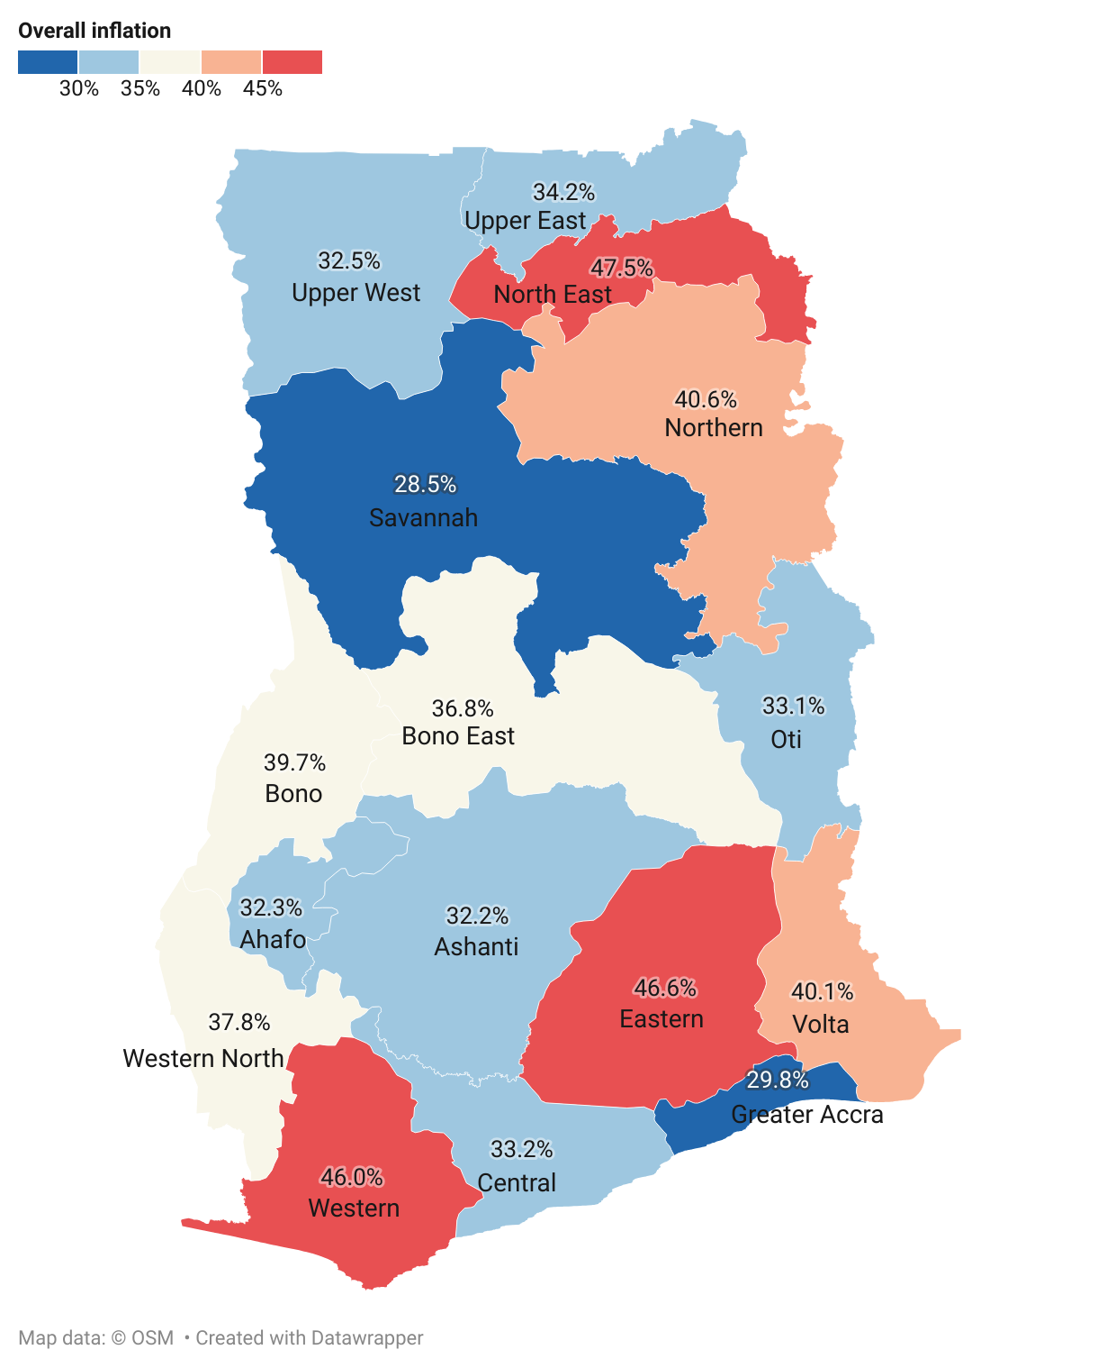
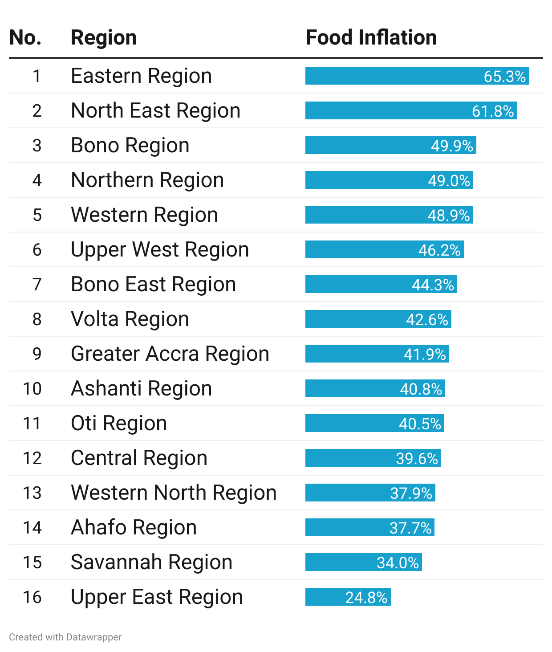
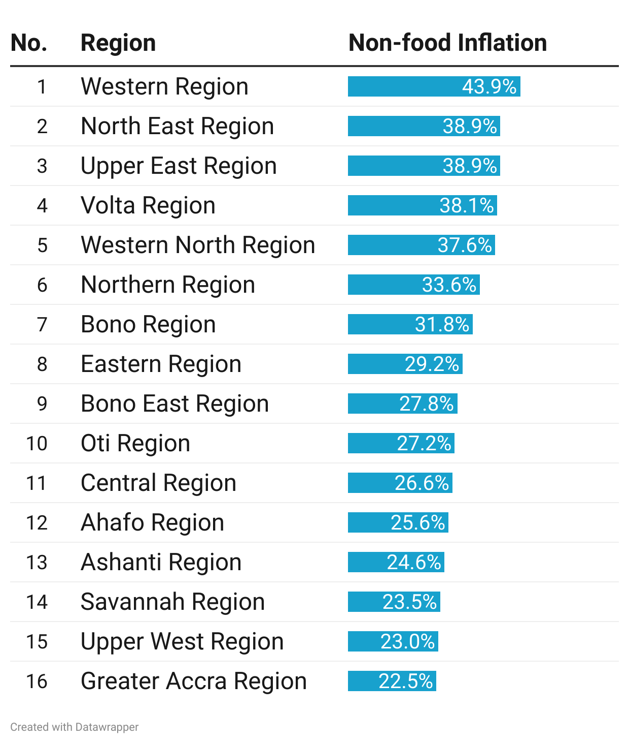
Regional Rates of Inflation for October 2023
12
Notes:
North East Region (47.5%) recorded the highest rate of inflation was closely followed by the Eastern (46.6%) and Western (46.0%) regions.
Eight regions (North East {47.5%}, Eastern {46.6%}, Western {46.0%), Volta {42.5%}, Northern {40.6%}, Bono {39.7%), Western North {37.8%}, Bono East {36.8%} and) recorded rates higher than the national average (35.2%)
Eastern Region recorded the highest food inflation (65.3%) while Western Region had the highest for non-food inflation (43.9%).

Slide 14
Disaggregation of Overall Inflation for North East and Food Inflation for Eastern Region
13
Notes:
In North East Region, four divisions [Alcoholic Beverages, Tobacco and Narcotics (69.5%); Food and Non-Alcoholic Beverages (61.8%) and Personal Care, Social Protection and Miscellaneous Goods (48.8%) recorded rates higher than the regional average (47.5%).
The main drivers of Food Inflation in the Eastern Region are Ready-made food and other food products, Fish and other sea and Vegetables, Tubers, Plantains, Cooking Bananas Pulses.

Slide 15
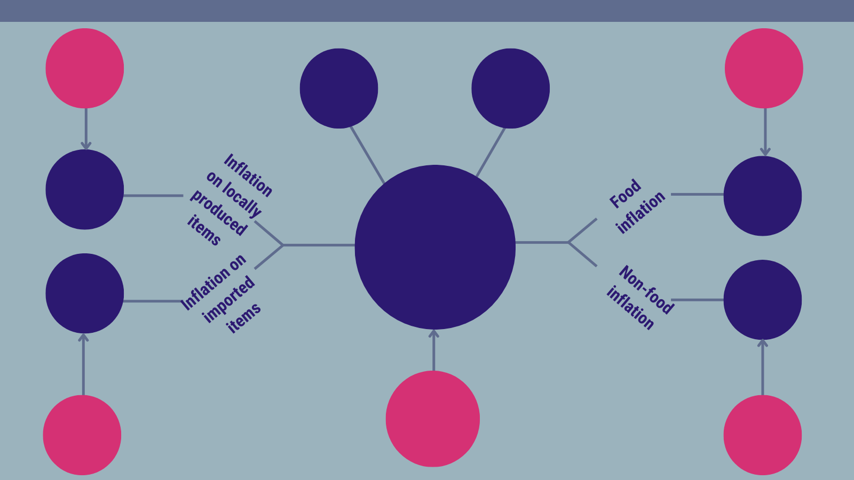
Highlights for October 2023 Rates of Inflation (1/2)
37.3%
Inflation on locally produced items
September 2023
49.4%
Food inflation
September 2023
47.5%
Highest regional inflation rate
North East)
28.5%
Lowest regional inflation rate
(Savannah)
34.4%
44.8%
35.2%
Year-on-year inflation
October 2023
37.0%
27.7%
38.1%
Year-on-year inflation
September 2023
39.9%
Inflation on imported items September 2023
29.3%
Non-food inflation
September 2023
Notes:
Y-o-Y inflation drops further by 2.9 percentage points.
Inflation for food items drops sharper (4.6 percentage points) than non-food (1.6 percentage points)
Both inflation for imported items and locally produced items drop by (2.9 percentage points).
North East Region recorded the highest overall (47.5%), food (81.1%) and non-food inflation (50.8%)

Slide 16
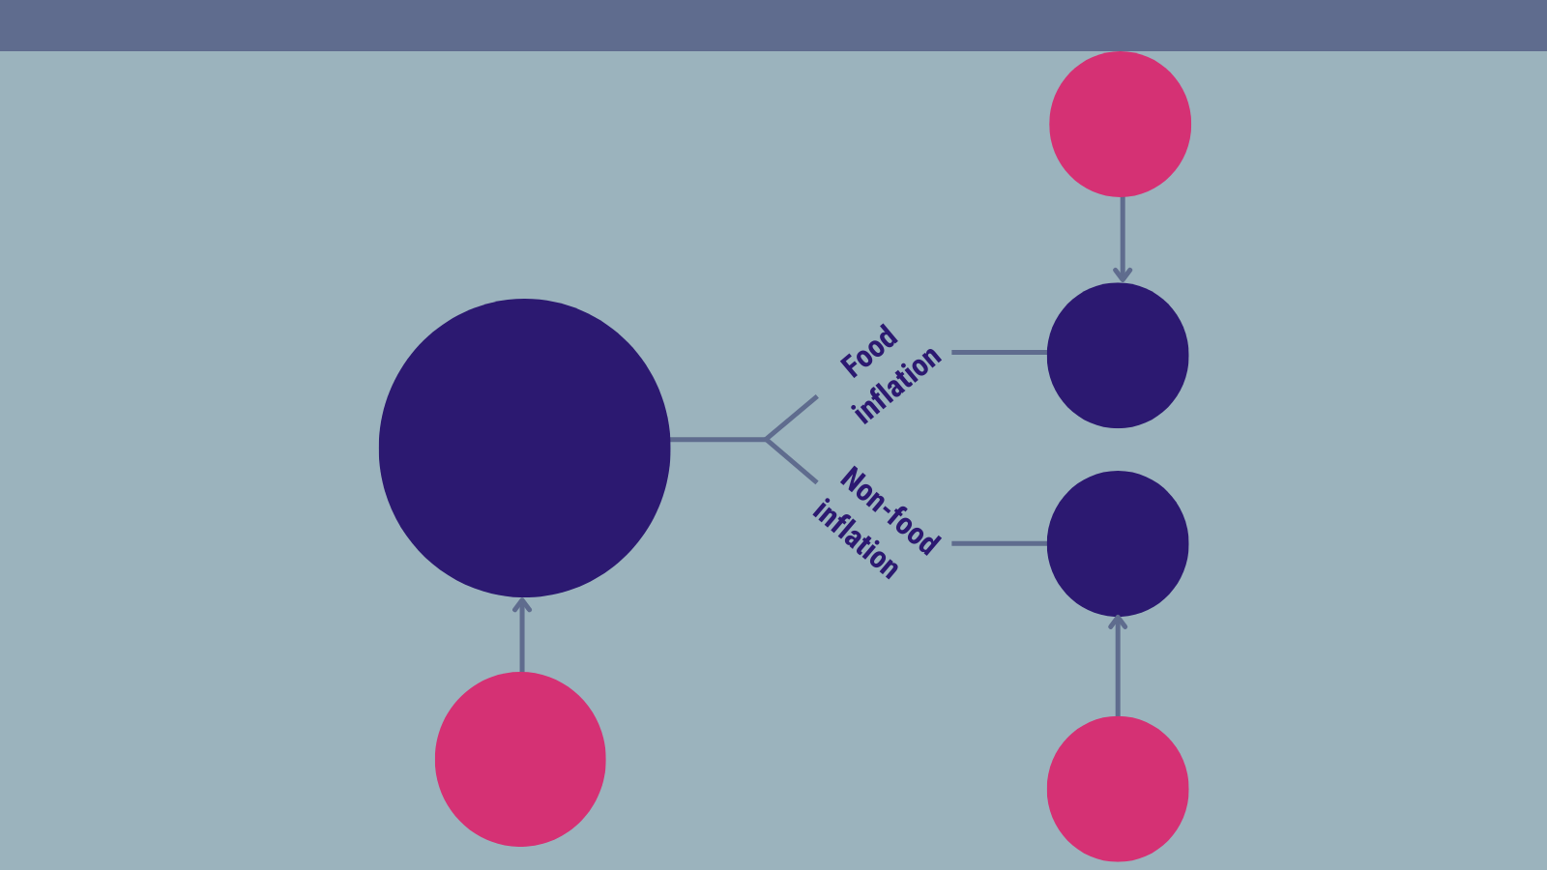
Highlights for October 2023 Rates of Inflation (2/2)
1.6%
Food inflation
September 2023
0.1%
0.6%
Month-on-month inflation
October 2023
1.0%
1.9%
Month-on-month inflation
September 2023
2.1%
Non-food inflation
September 2023
Notes:
Month-on-month inflation clows down by 1.6 percentage points.
The drop in food inflation (1.5 percentage points) is steeper than non-food inflation (1.1 percentage points)

Slide 17
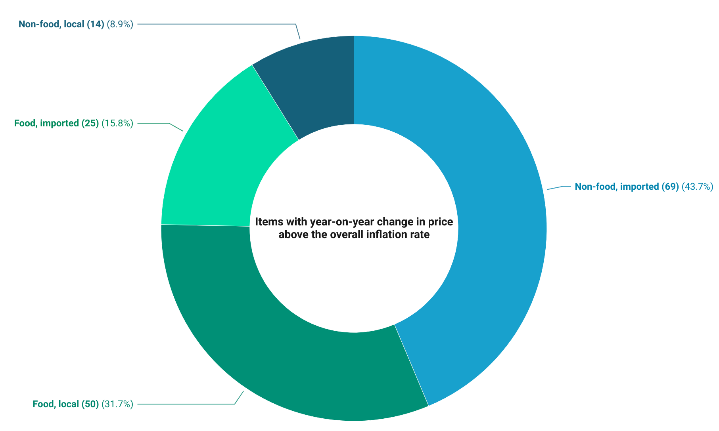
National-Level Issues for Wider Engagement (1/2)
16
Notes:
158 (51.5%) items recorded price changes higher than the national inflation rate (35.2%)
Non-food imported items constituted more than two-fifths of these items.
The number of food items produced locally was the second highest (31.7%)

Slide 18
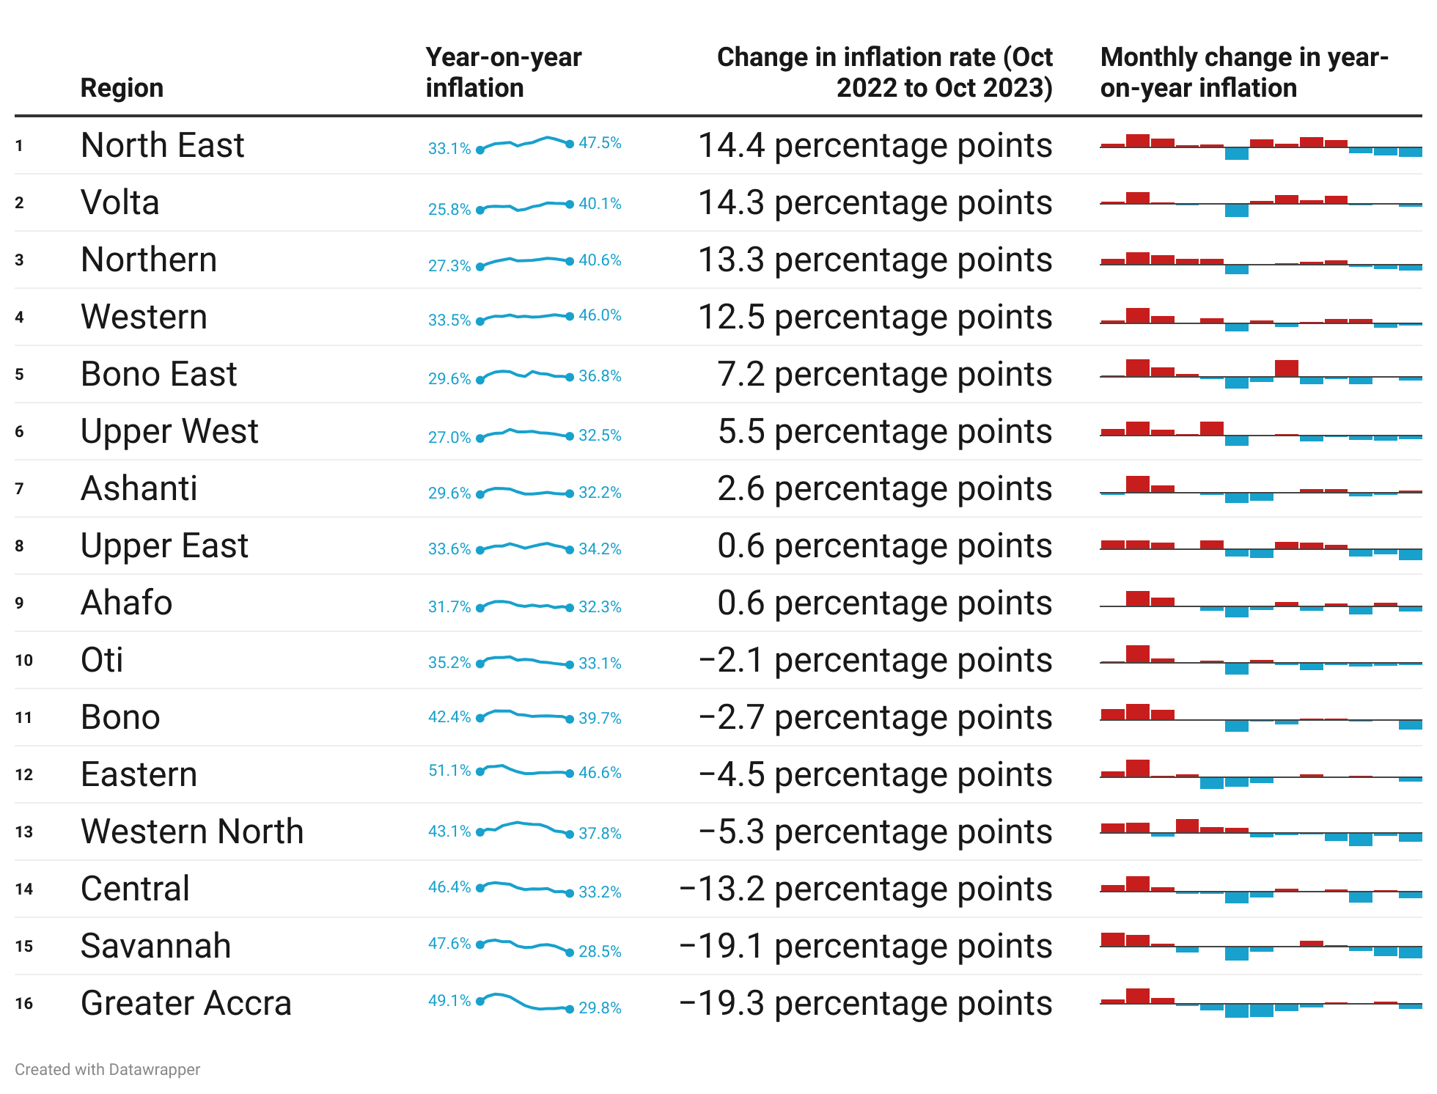
National and Household-Level Issues for Wider Engagement (2/2)
17
Notes:
Seven regions (Oti, Bono, Eastern, Western North, Central, Savannah and Greater Accra) record a slow down in their rates of inflation between October 2022 and 2023.

Slide 19
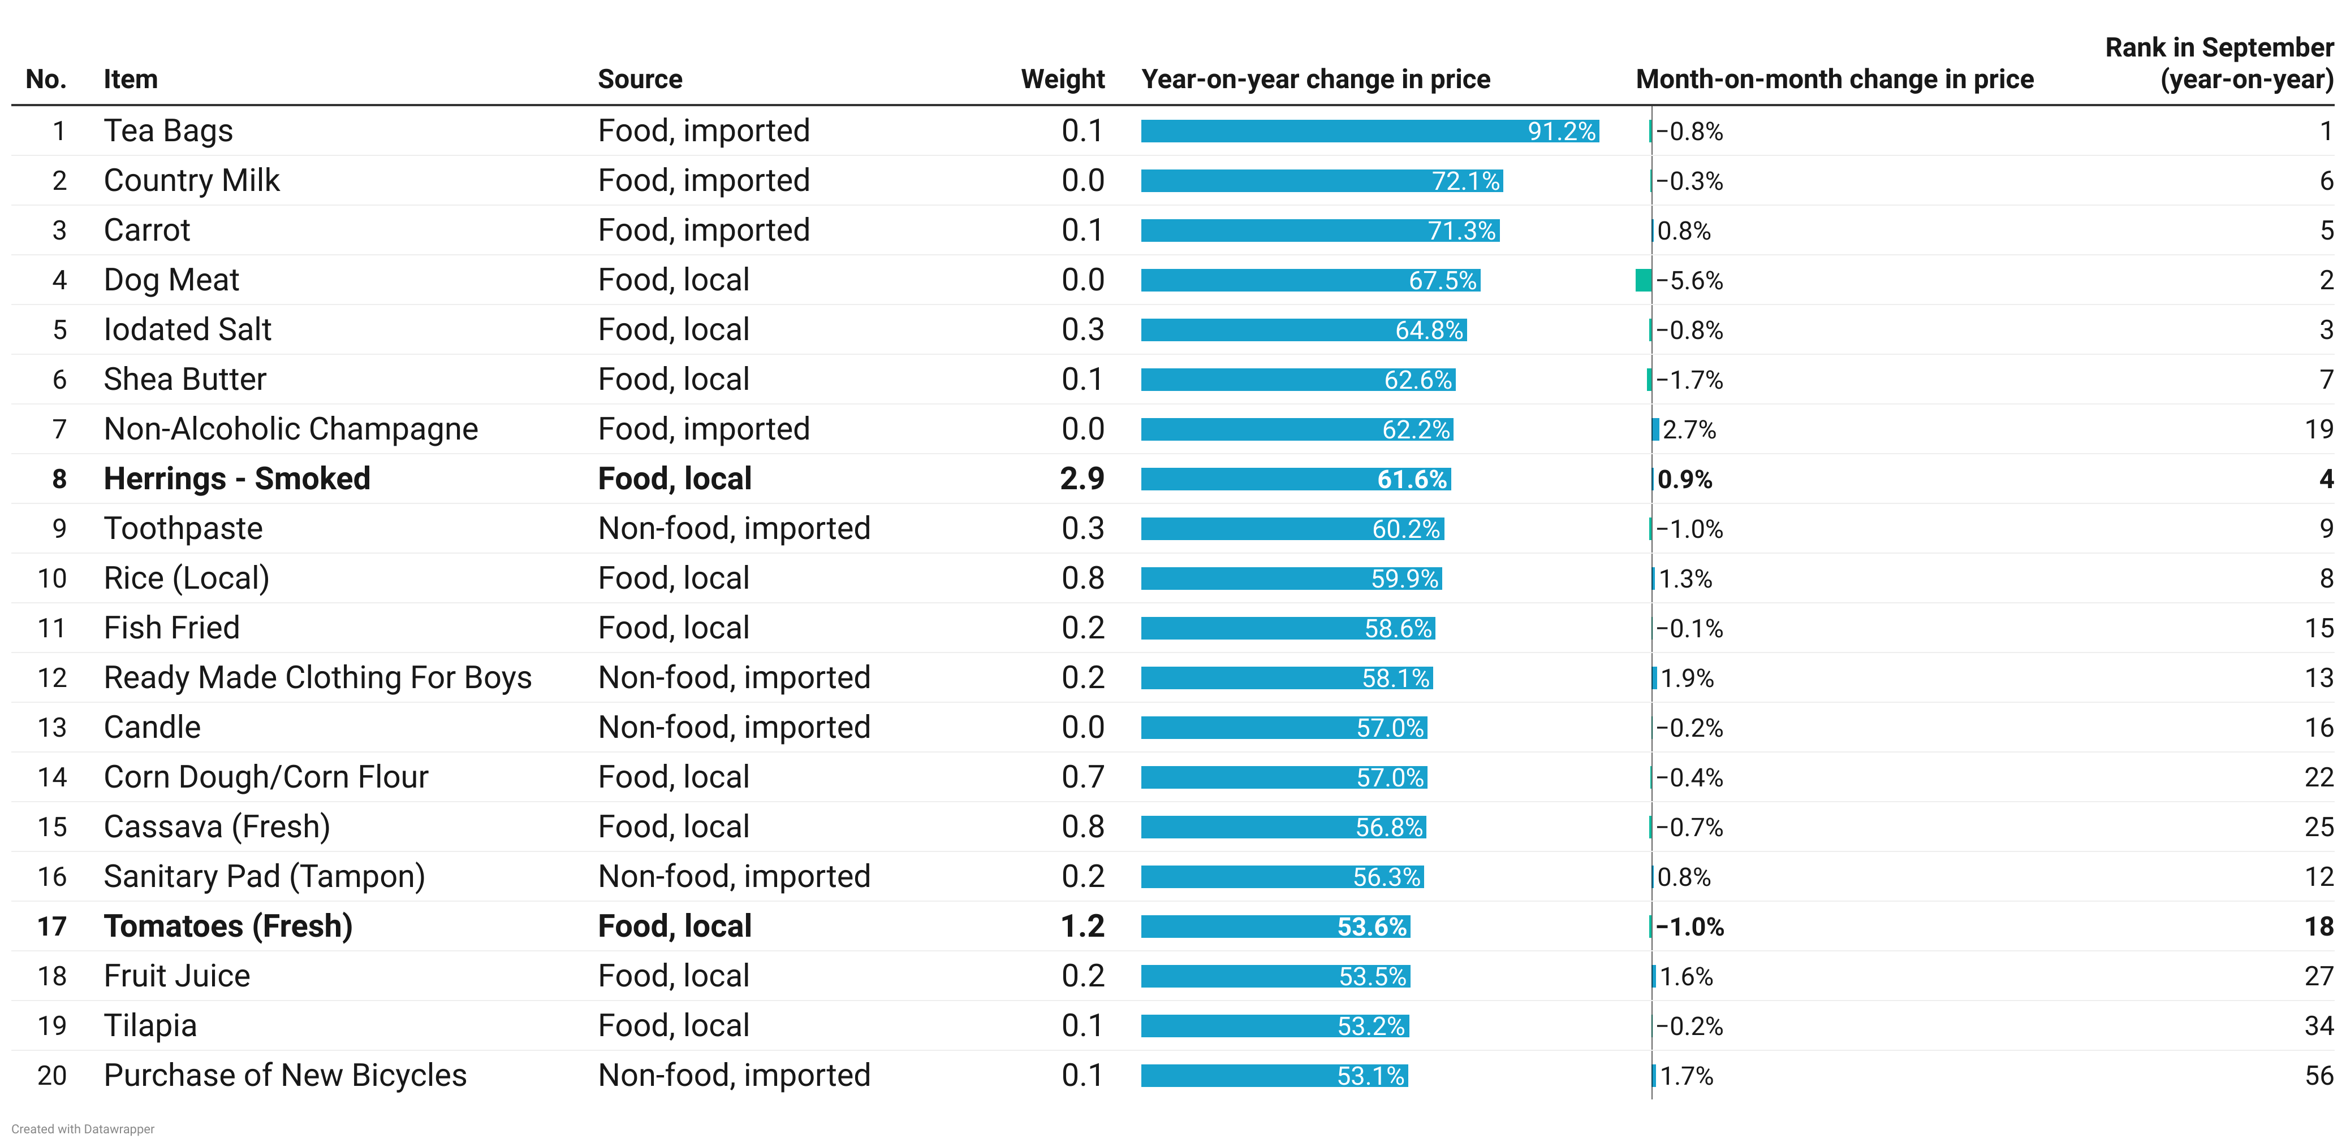
Regional-Level Issues for Wider Engagements
18
Notes:
Two items (Fresh Tomatoes [1.2] and Smoked Herrings [2.9]) with significant weights (> one) remain in the list of the 20 items with the highest year-on-year changes in price.
Five new item entrants (Corn Dough/Corn Flour; Fresh Cassava, Fruit Juice, Tilapia and New Bicycles) have been ranked in the list of the 20 items with the highest year-on-year changes in price.

Slide 20
End of Press Release for October 2023 Consumer Price Index
For enquiries, please contact:
Mr. J. F.K. Agyaho
(Head, Price Statistics, GSS)
john.agyaho@statsghana.gov.gh
Download the technical guide:
https://statsghana.gov.gh/gssmain/fileUpload/Price%20Indices/CPI_Technical_Guide_v5_Published_14102020.pdf

Slide 21
Consumer Price Index and Inflation
October 2023

